Slide 1
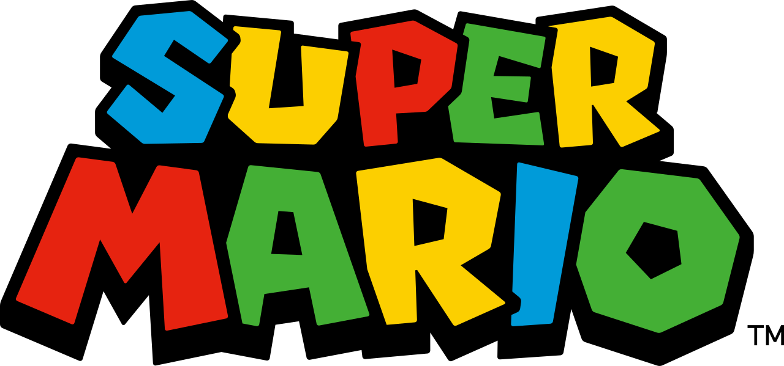
Super Mario

Slide 2
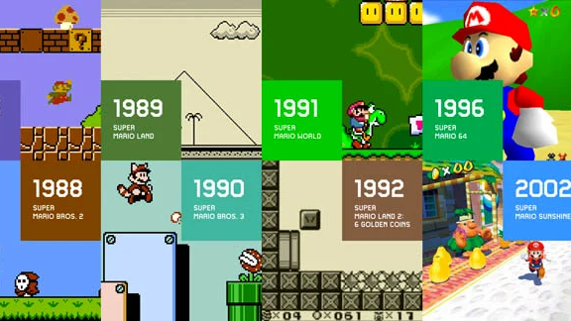
Super Mario Bros

Slide 3
What are the characteristics of Super Mario Bros?

Slide 4
Key characteristics (requirements)
Side scroller: Mario/Camera moves right
Gravity effect of jump
Collects coins and optional powerups
Enemies (Goombas) try to take lives.
Time limit in which Mario must reach the end of the level
Notes:
https://protipoftheday.com/node/113.html

Slide 5
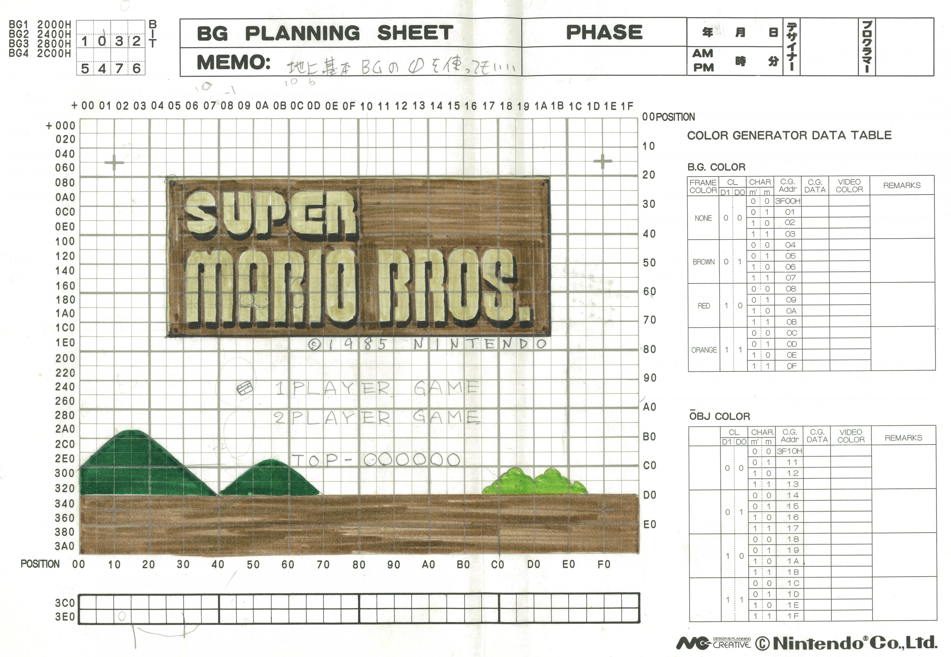
Paper design!

Slide 6
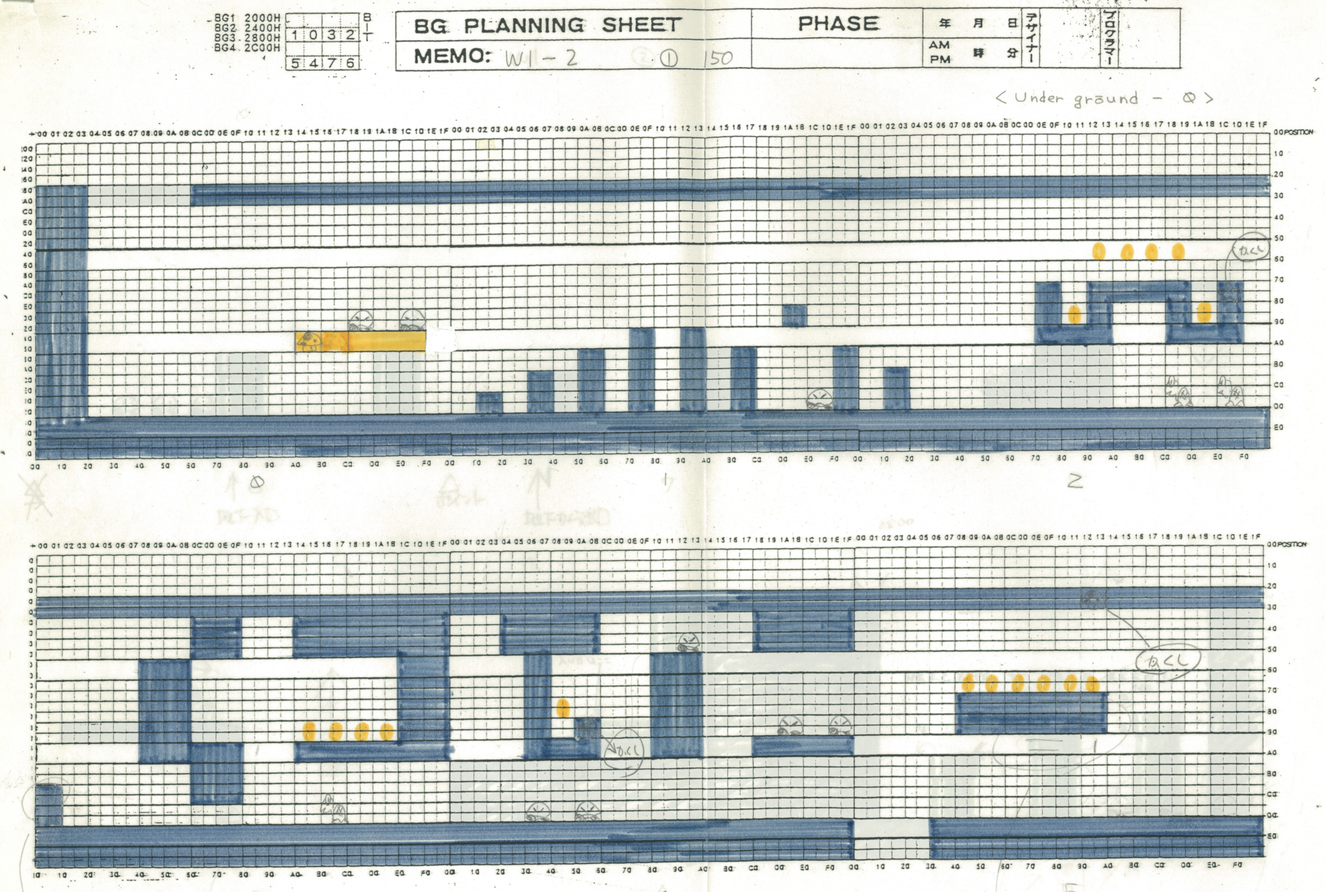
Paper design!

Slide 7
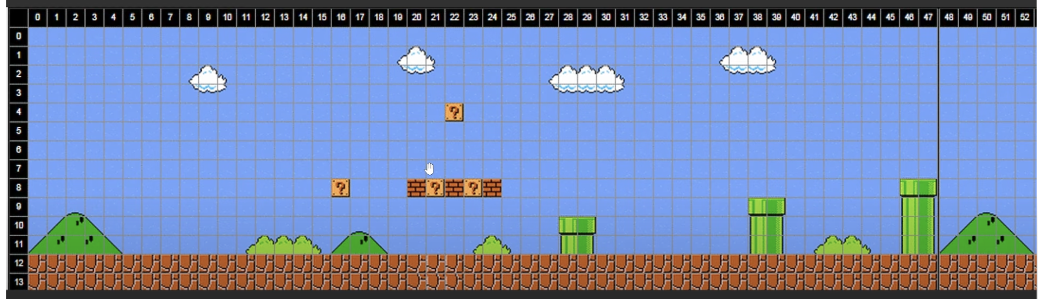
Unity tilemap

Slide 8
How do we design a solution to this?
Mario would move right (optionally left if levels allows)
Move coordinates (x) when respond to left and right key press
The array of blocks
2D array of graphics?
Moving camera with Mario
An x coordinate to keep a track of this?
Compare x/y coordinates?
Jump - gravity
Change the x and y coordinates accordingly

Slide 9
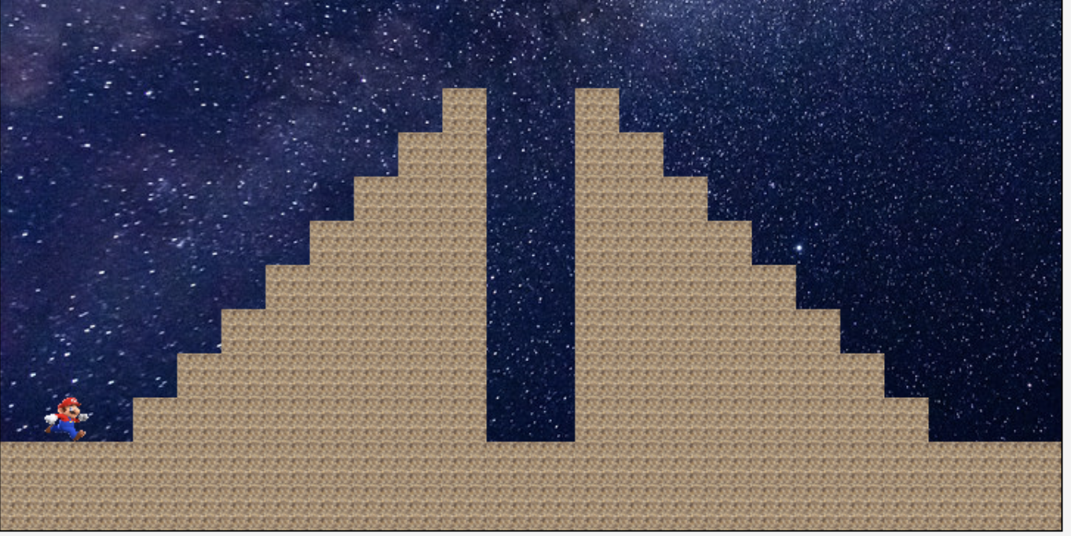
2D Array?

Slide 10
2D Array?
0 1 2 3
4 5
6
7

Slide 11
2D Array?
0 1 2 3 4 5 6 7 8 9 10 11 12 13 14 15 16 17
0 1 2 3
4 5
6
7

Slide 12
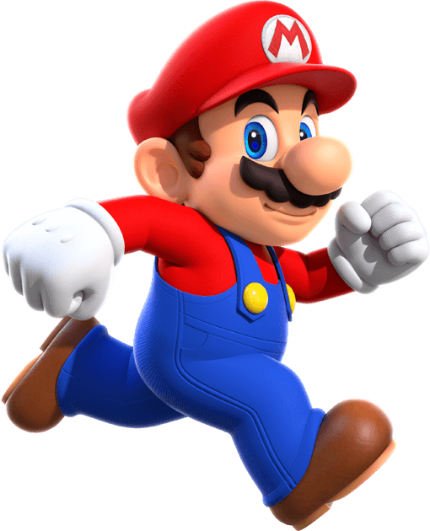

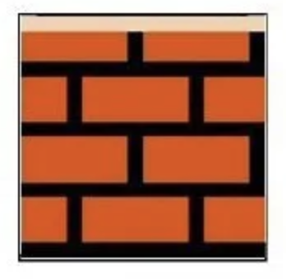
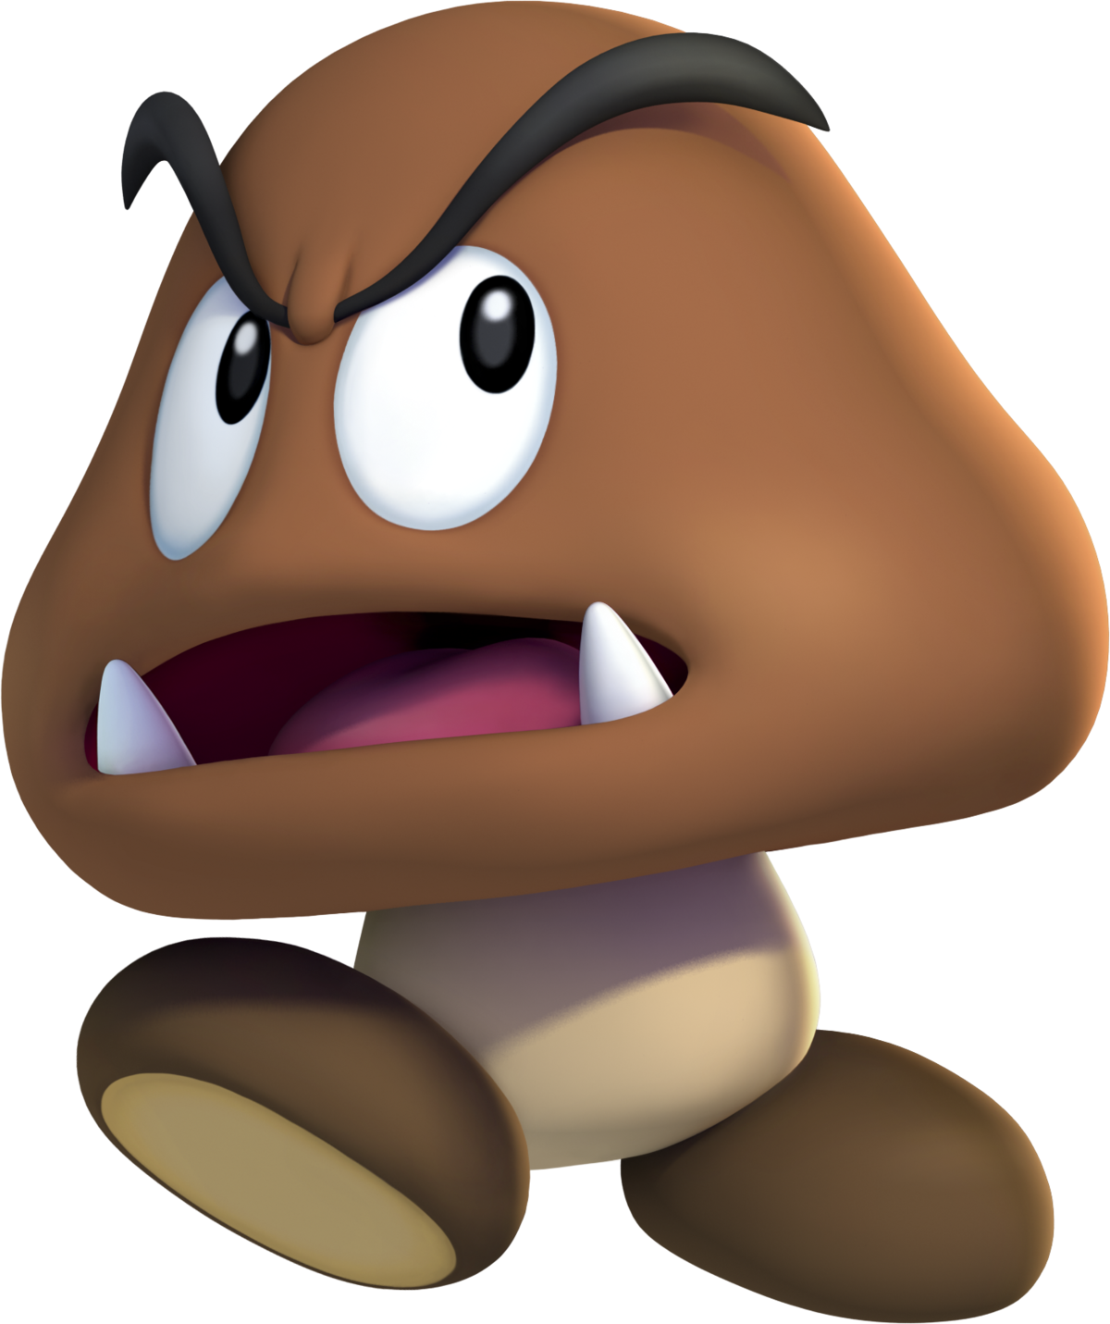
What about OOP?
Should we build some of these entities as classes?
Notes:
https://www.raspberrypi.com/news/coding-space-invaders-disintegrating-shields-wireframe-9/
https://spaceinvaders.fandom.com/wiki/UFO
https://opensea.io/assets/matic/0x2953399124f0cbb46d2cbacd8a89cf0599974963/44780268195173871161572035472768948089987869065093867251645780525528479957092

Slide 13


Slide 14
Steps / Requirements
Level Design in Unity
Mario Movement (left + right)
Object detection / collision
Jumping over blocks / gravity
Enemies (Goombas) alternate directions
Jumping on Goombas – further collisions
Decoration – animation – walking
Camera to track Mario (once tile map created)

Slide 15
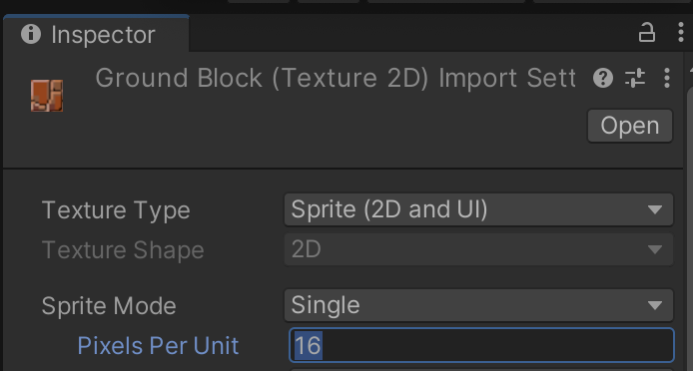
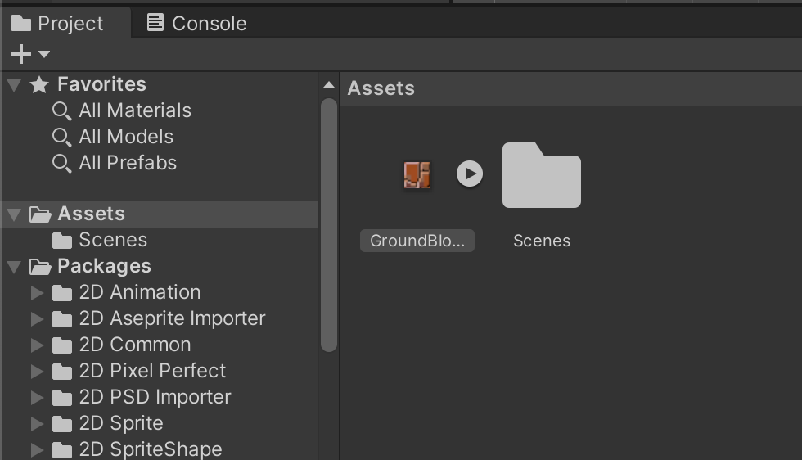
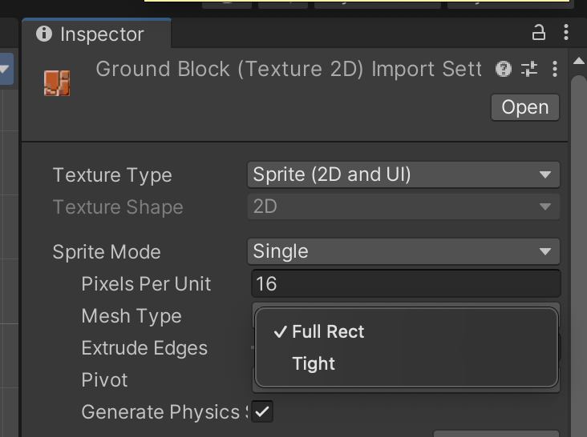
Level Design - load in Ground Block Pixels Per Unit = 16

Slide 16
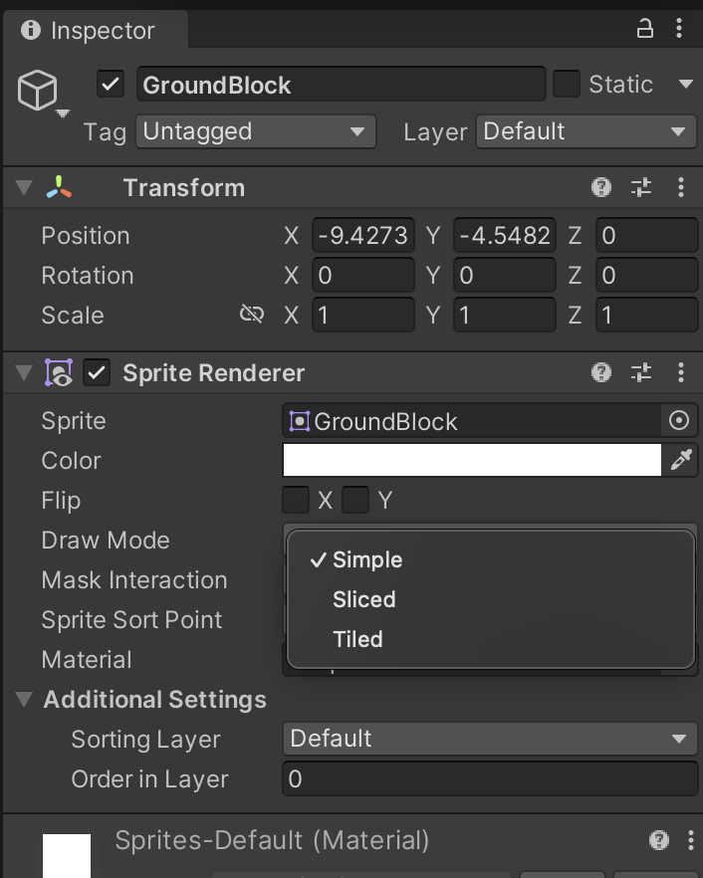
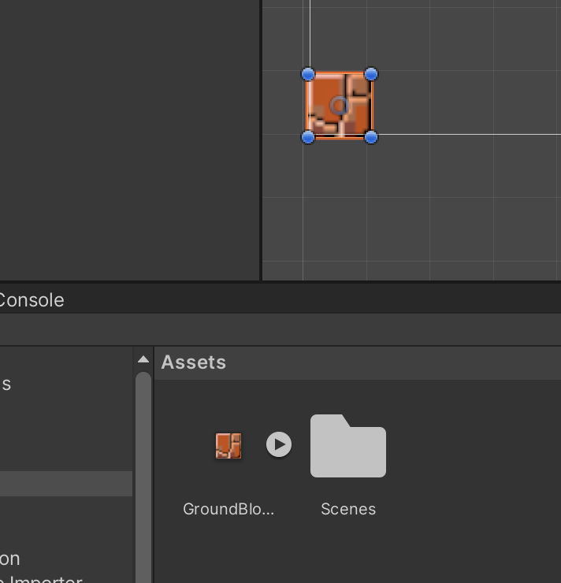
Select ‘Tiled’

Slide 17
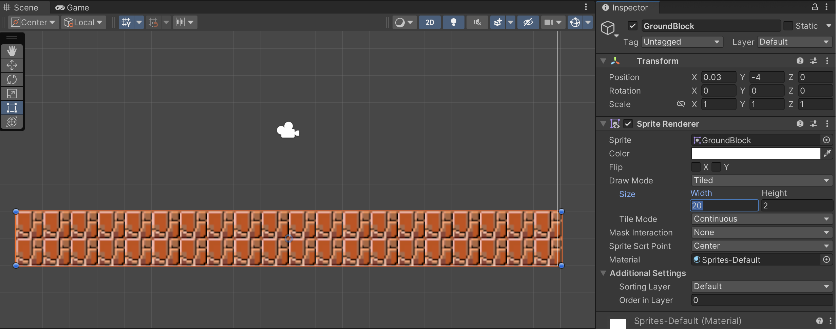
Tiled Draw Mode – 20 tiles wide x 2 high

Slide 18
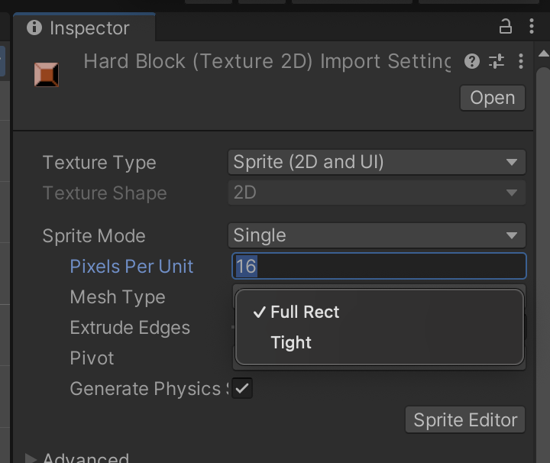
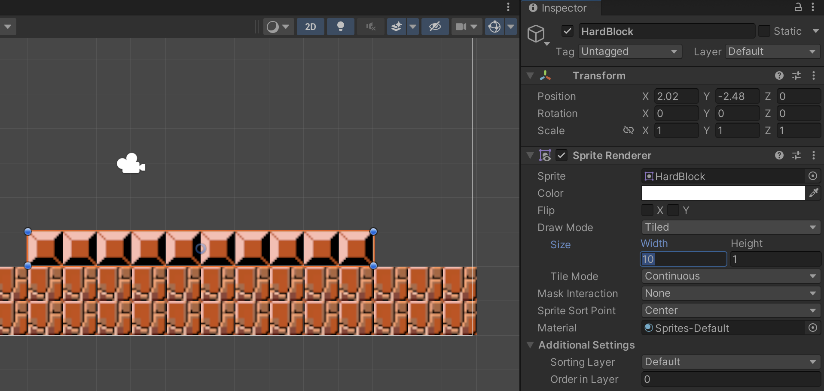
In Unity – Select Tiled

Slide 19
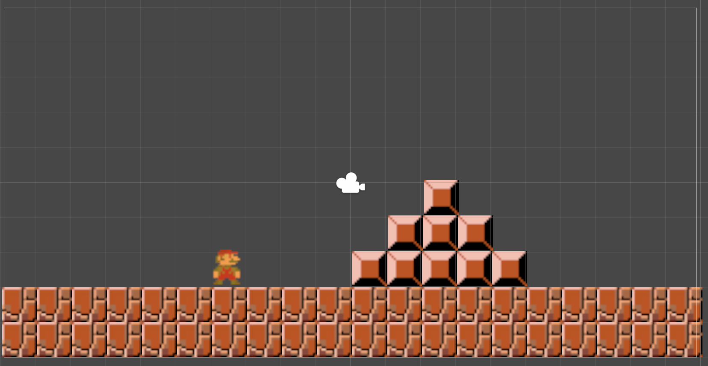
Simple Level Design

Slide 20
Steps / Requirements
Level Design in Unity ✅
Mario Movement (left + right)
Object detection / collision
Jumping over blocks / gravity
Enemies (Goombas) alternate directions
Jumping on Goombas – further collisions
Decoration – animation – walking
Camera to track Mario (once tile map created)

Slide 21
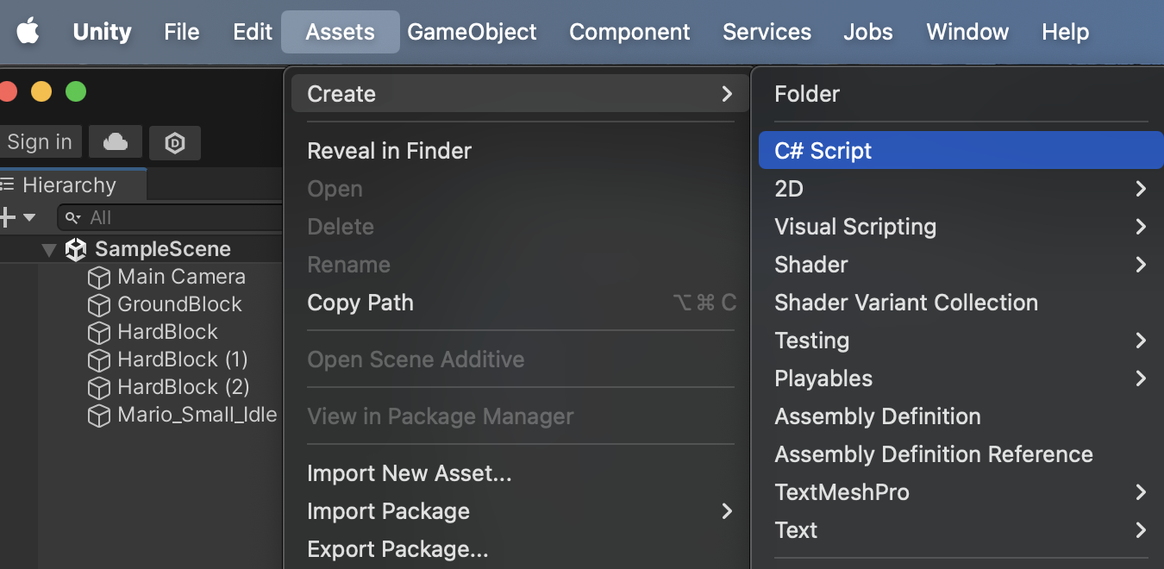
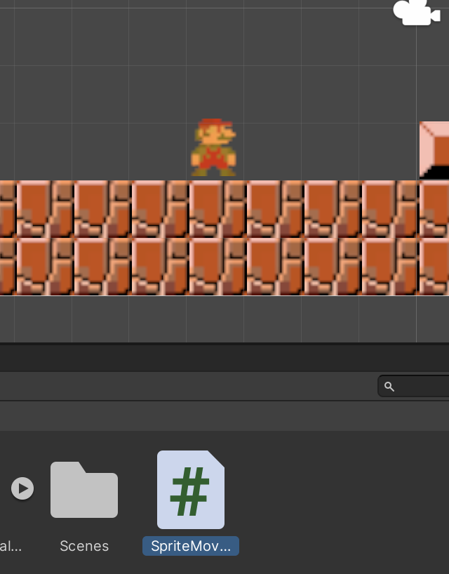
2. Mario Movement
Player

Slide 22
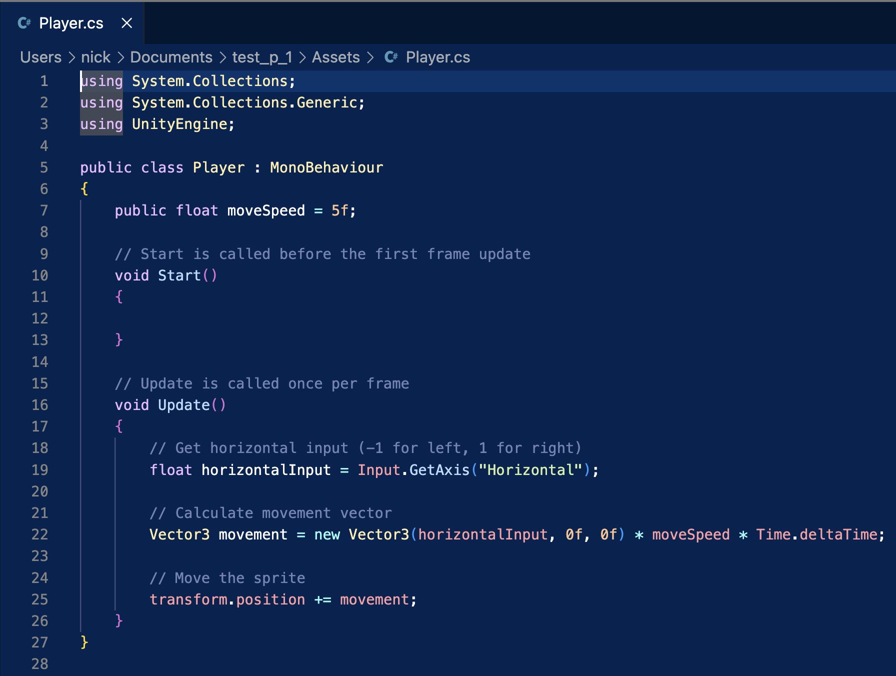
2. Mario Movement

Slide 23
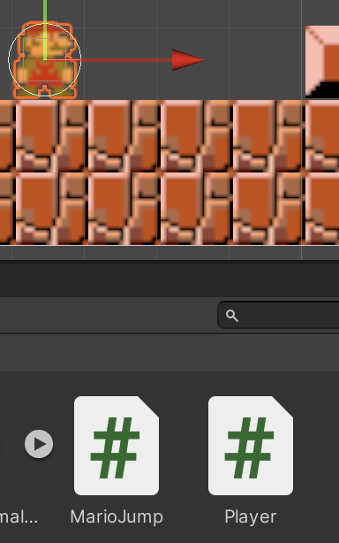
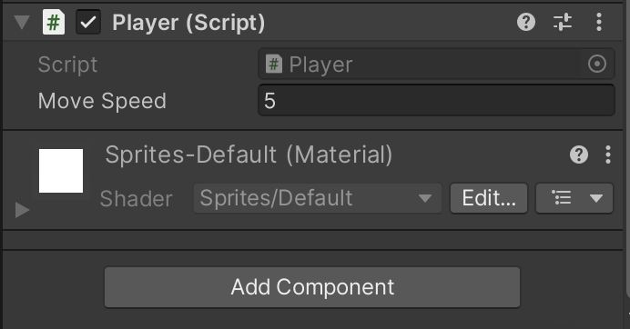
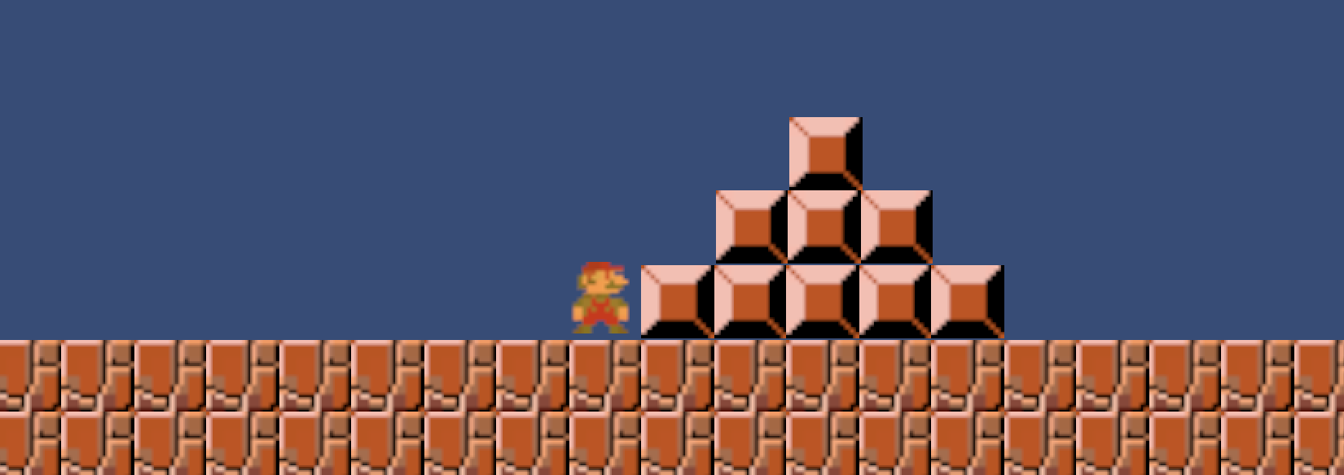
2. Mario Movement

Slide 24
Steps / Requirements
Level Design in Unity ✅
Mario Movement (left + right) ✅
Object detection / collision
Jumping over blocks / gravity
Enemies (Goombas) alternate directions
Jumping on Goombas – further collisions
Decoration – animation – walking
Camera to track Mario (once tile map created)

Slide 25
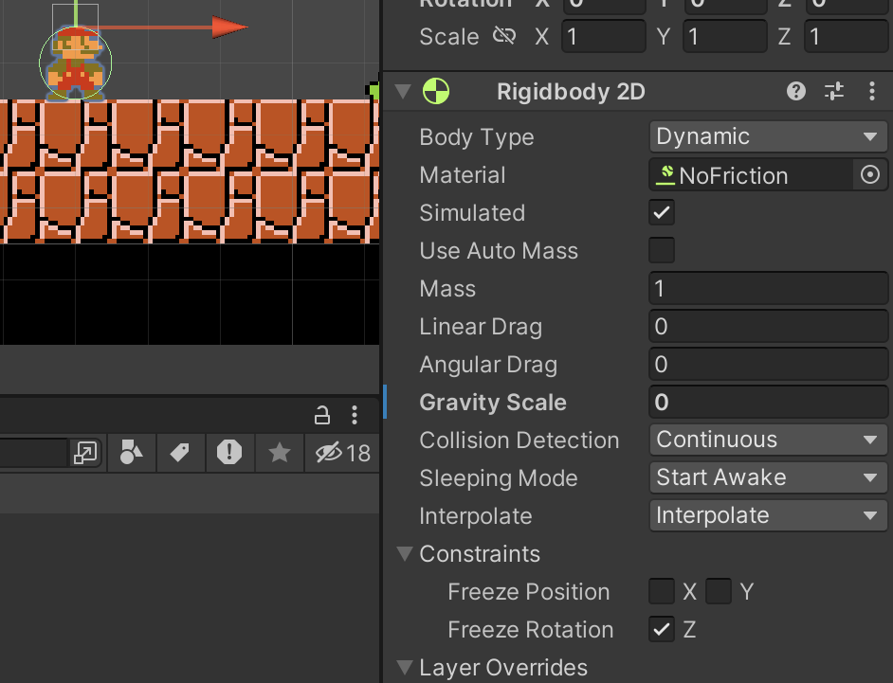
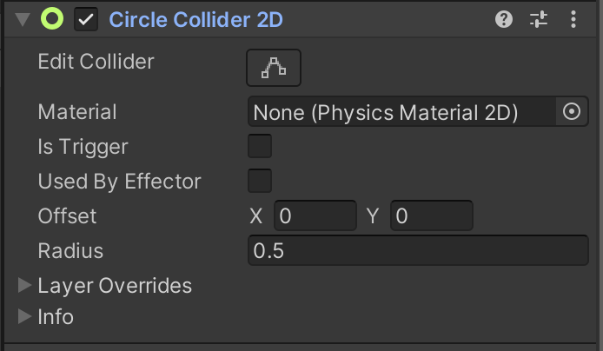
3. Object Detection – Colliders for Mario
Click on Mario – add new Component -> Physics -> Rigidbody 2D
Click on Mario – add new Component -> Physics -> Circle Collider 2D
Notes:
Click on Mario – add new Component -> Physics -> Circle Collider 2D

Slide 26
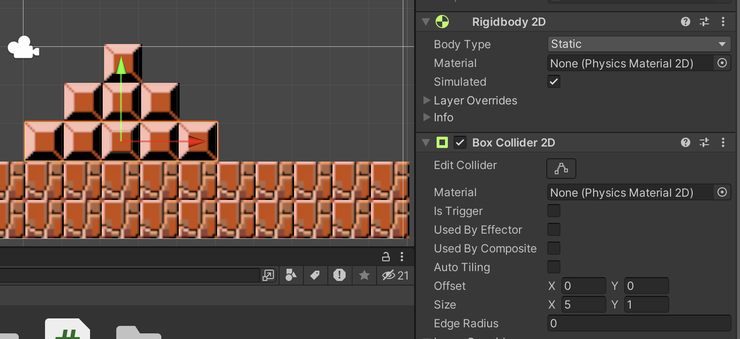
3. Object Detection – Colliders for Block
Click on Block – add new Component -> Physics -> Rigidbody 2D
Click on Block – add new Component -> Physics -> Box Collider 2D
Notes:
Click on Block – add new Component -> Physics -> Box Collider 2D

Slide 27
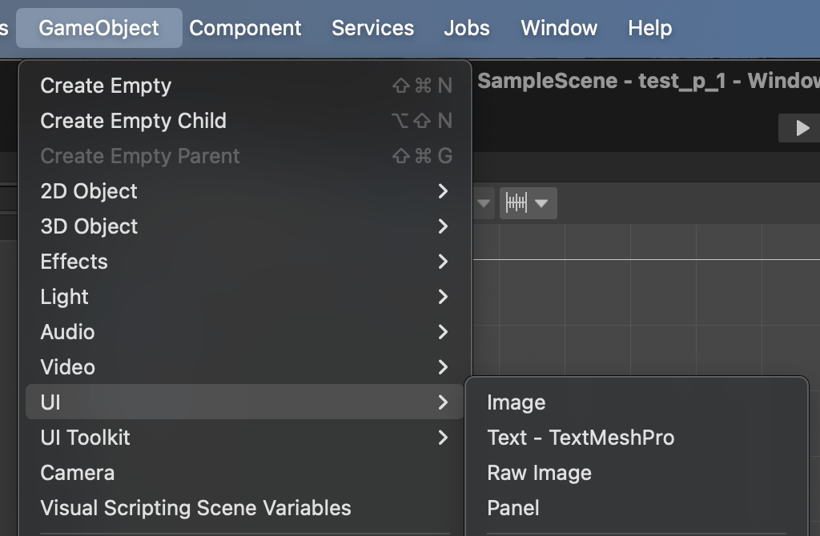
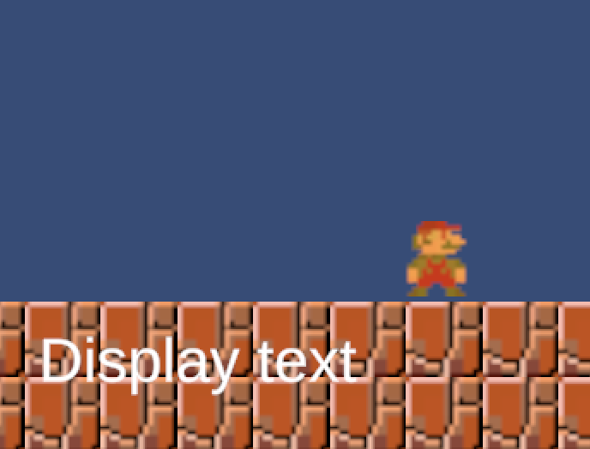
3. Collision text – for visual cues
GameObject -> UI -> Text - TextMeshPro

Slide 28
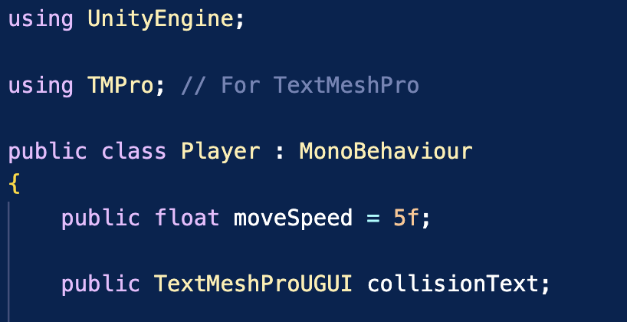
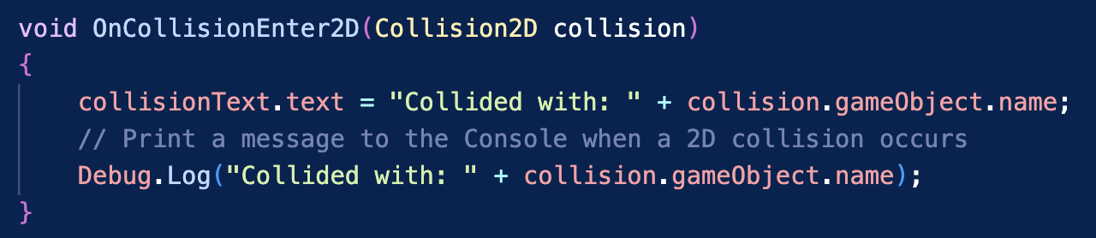
3. Collision code in our C# Script - for visual cues

Slide 29
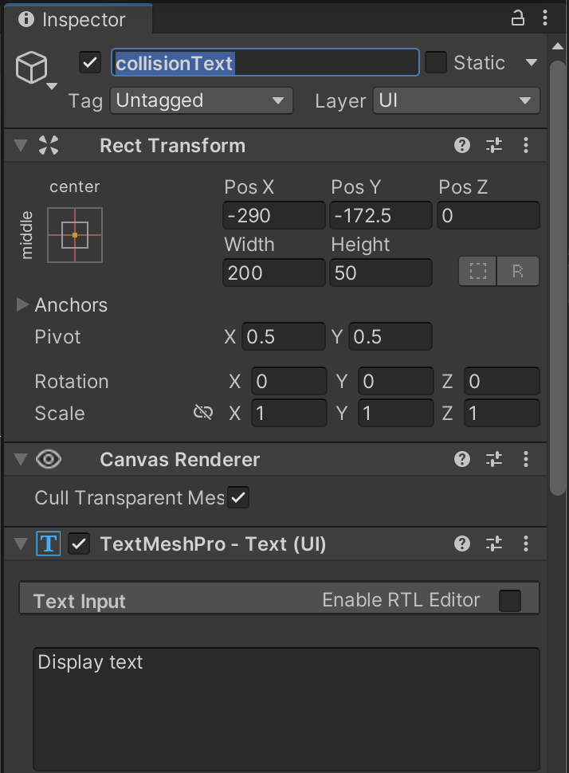
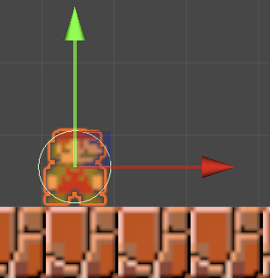
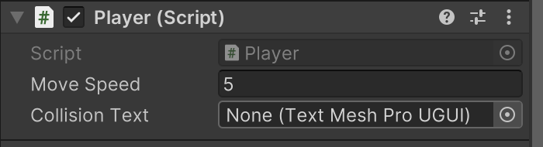
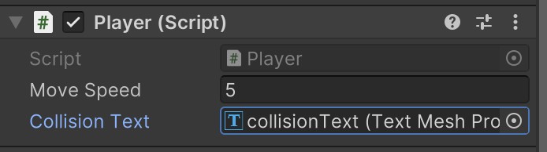
3. Update parameters in the Inspector

Slide 30
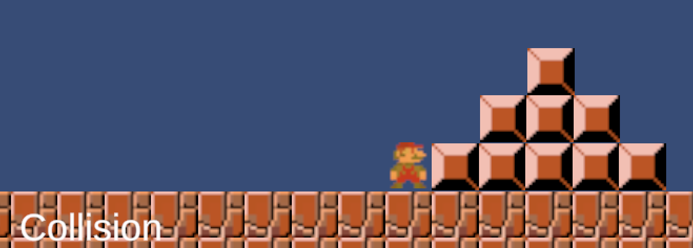
3. Change the TextMesh.text upon collision!
Notes:
Eventually helpful for drawing scores, times etc

Slide 31
Steps / Requirements
Level Design in Unity ✅
Mario Movement (left + right) ✅
Object detection / collision ✅
Jumping over blocks / gravity
Enemies (Goombas) alternate directions
Jumping on Goombas – further collisions
Decoration – animation – walking
Camera to track Mario (once tile map created)

Slide 32
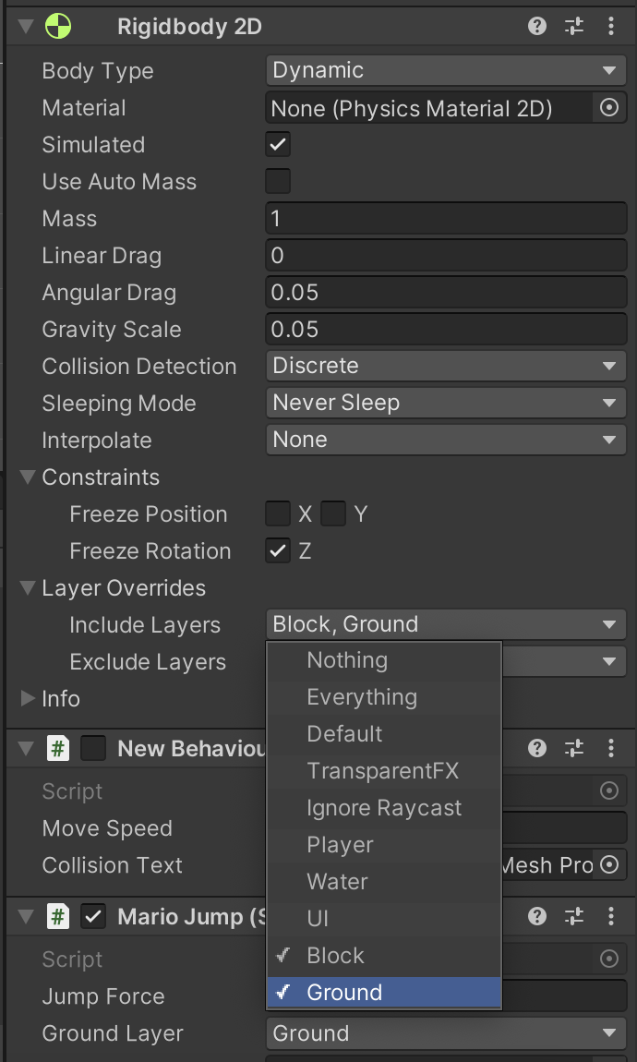
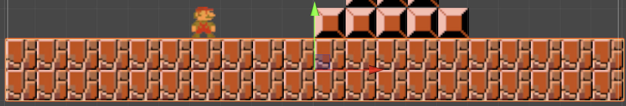
4. Gravity / Jump – Mario
Start by setting Mario’s RigidBody 2D Gravity to a low value > 0 but < 1 so you can check whether he falls through the floor or not…
Also make sure to ‘INCLUDE’ Ground tiles/layers you have

Slide 33
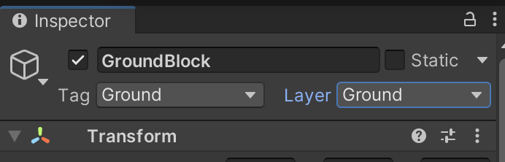
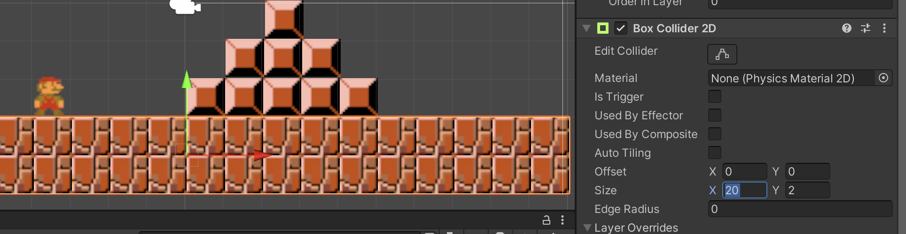
4. Gravity / Jump – Check Ground tiles
Ground tiles should only need a Box Collider 2D – I didn’t need to include a RigidBody 2D here

Slide 34
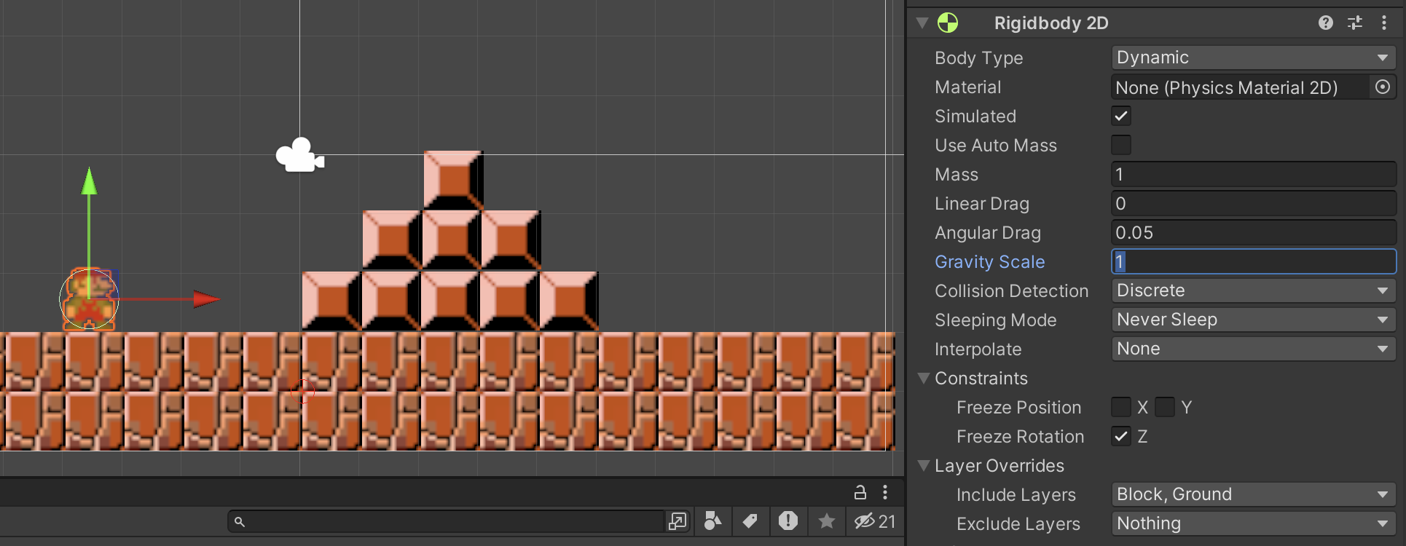
4. Gravity / Jump – Mario
If Mario doesn’t fall through the floor – then increase the Gravity Scale to 1 (or higher)

Slide 35
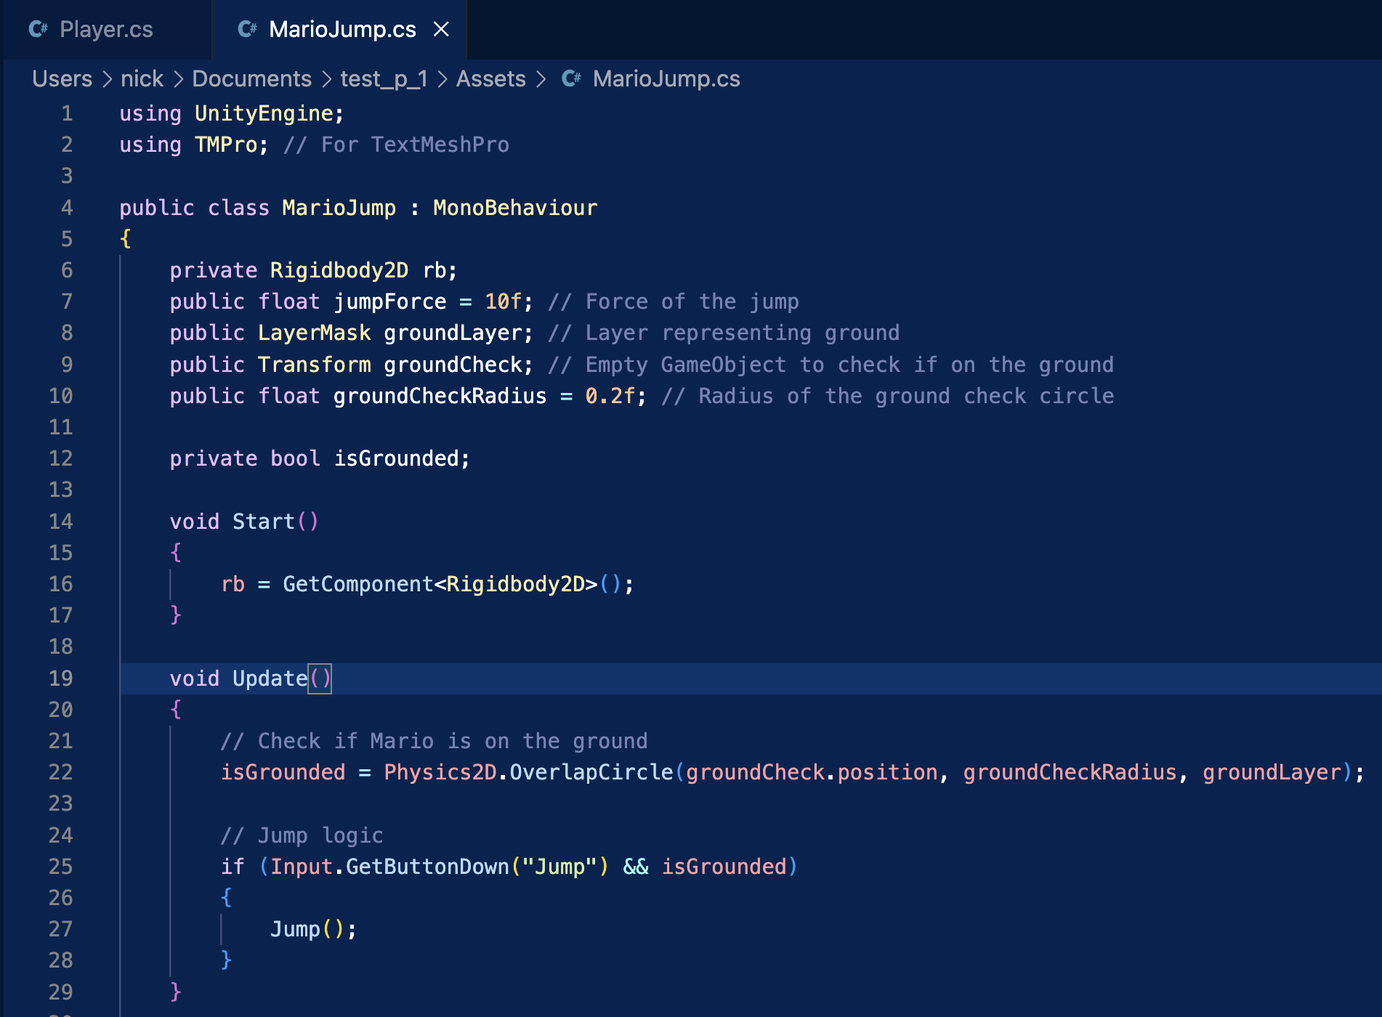
4. Gravity / Jump – C# Code

Slide 36
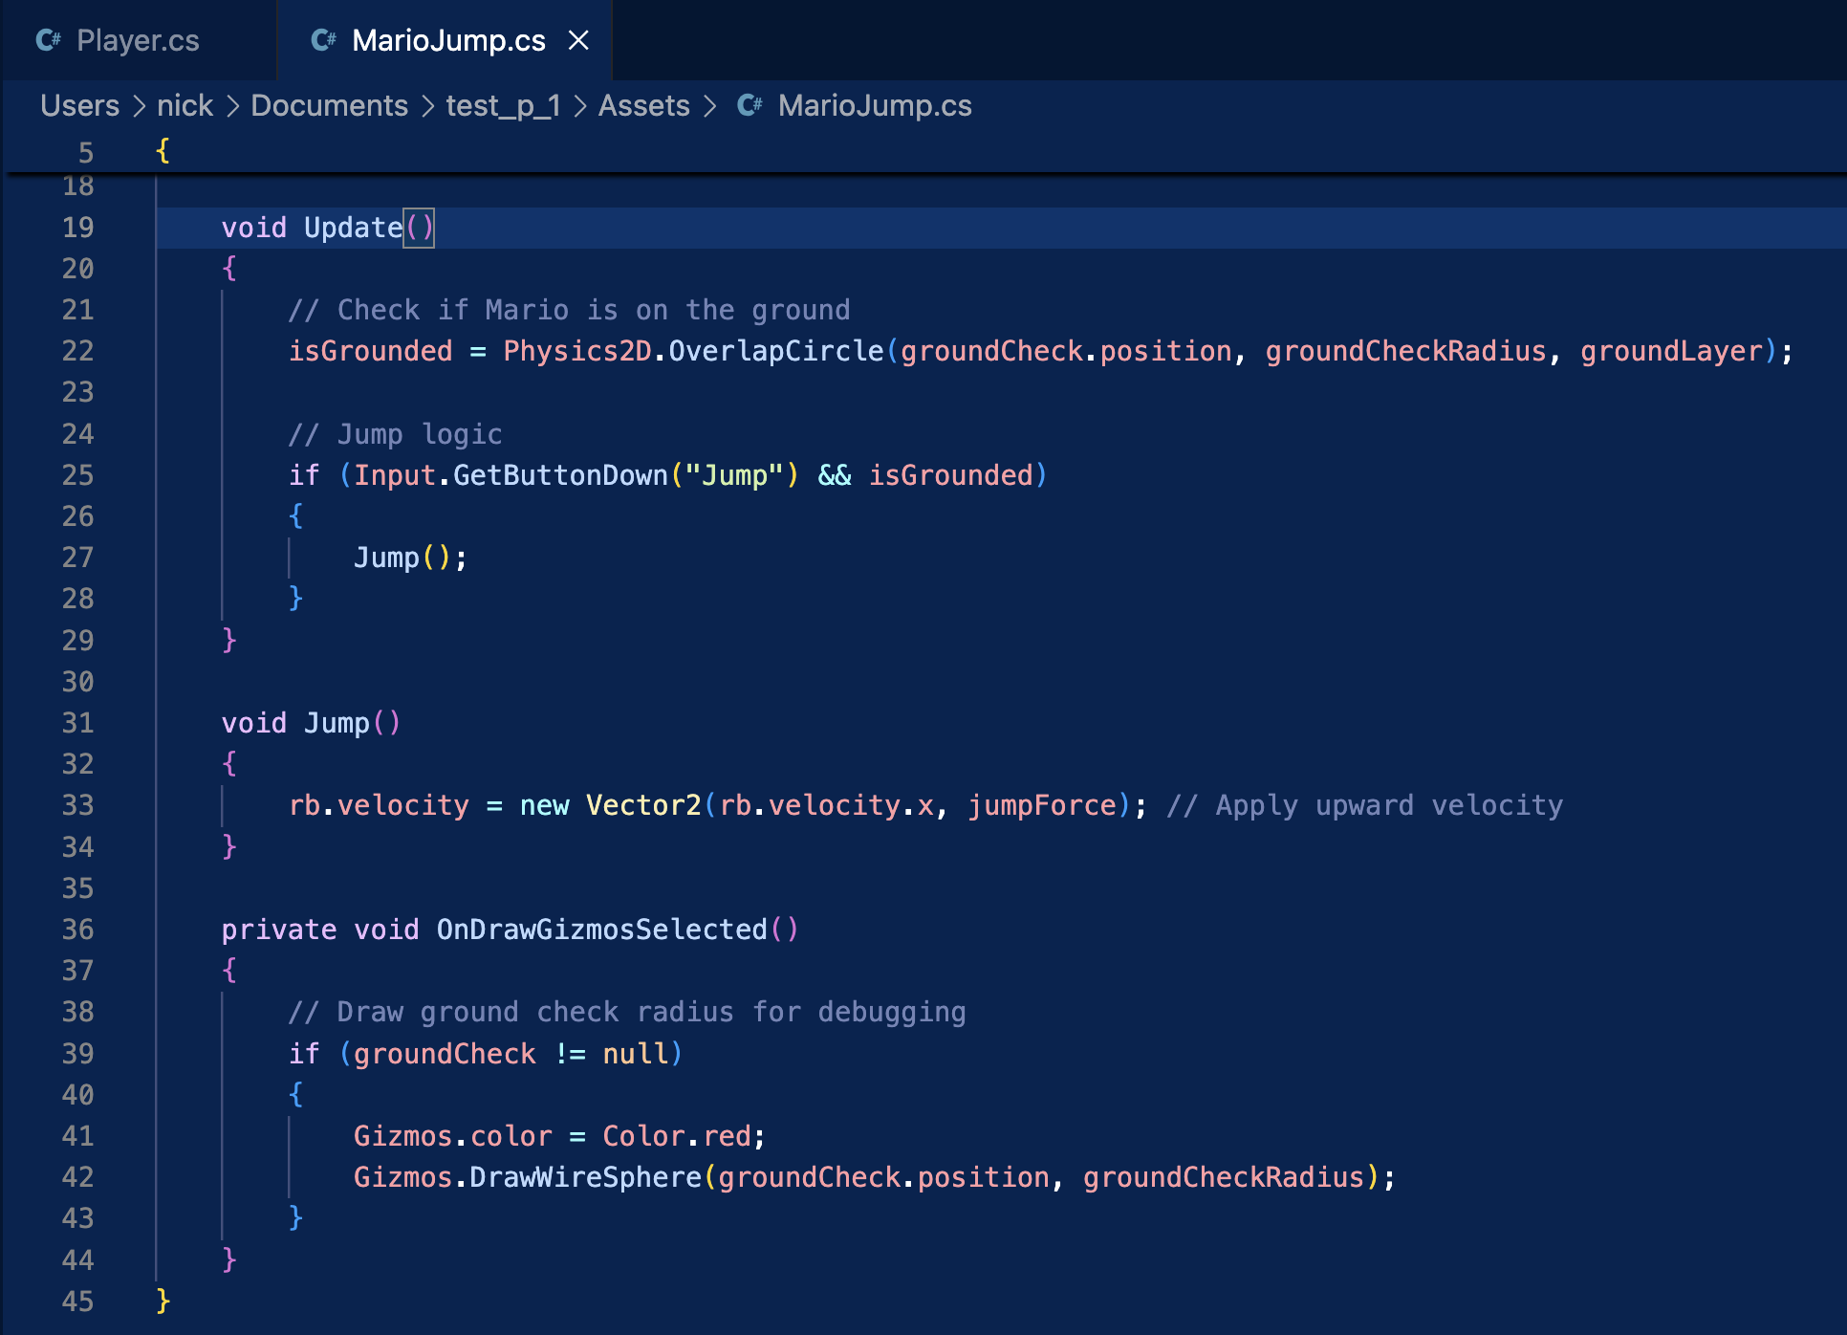
4. Gravity / Jump – C# Code

Slide 37
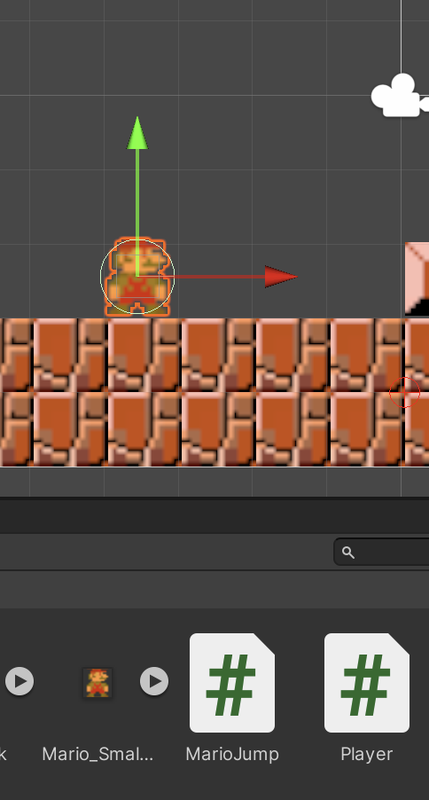
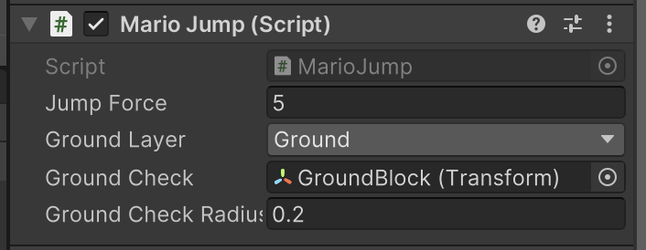
4. Gravity / Jump – Mario

Slide 38
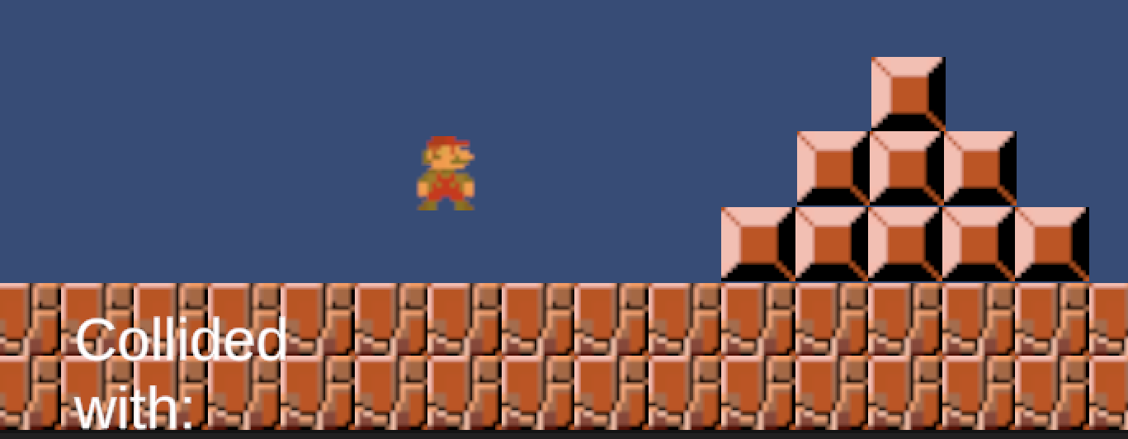
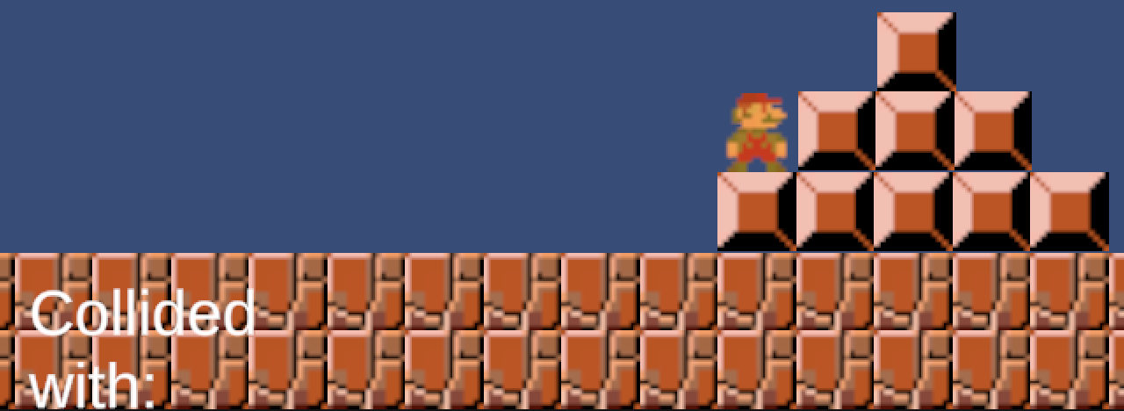
4. Gravity / Jump – Mario

Slide 39
Steps / Requirements
Level Design in Unity ✅
Mario Movement (left + right) ✅
Object detection / collision ✅
Jumping over blocks / gravity ✅
Enemies (Goombas) alternate directions
Jumping on Goombas – further collisions
Decoration – animation – walking
Camera to track Mario (once tile map created)

Slide 40
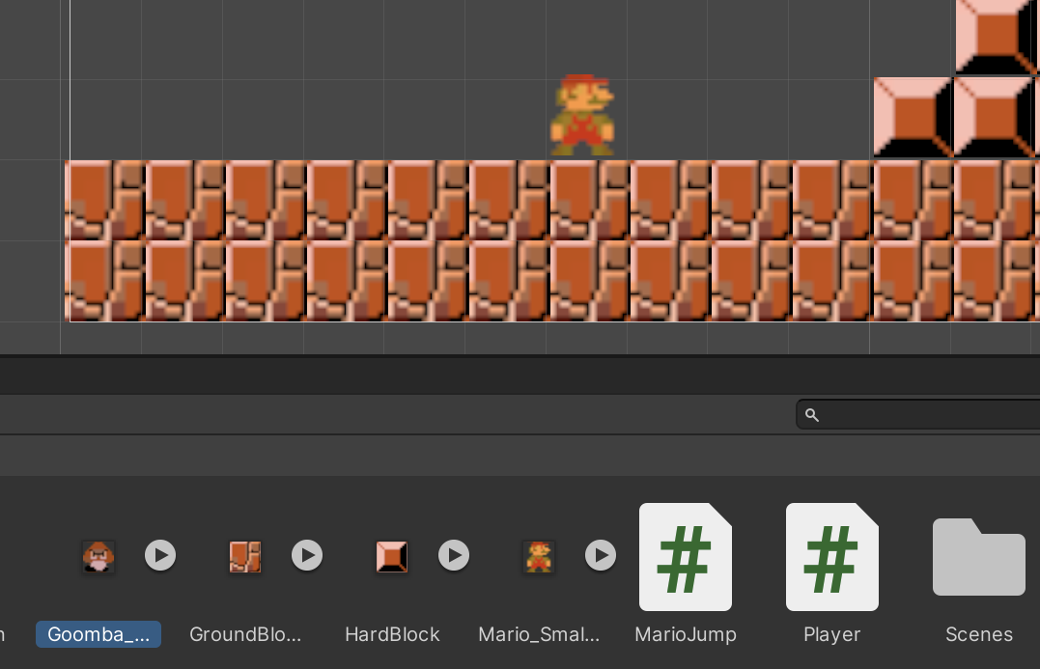
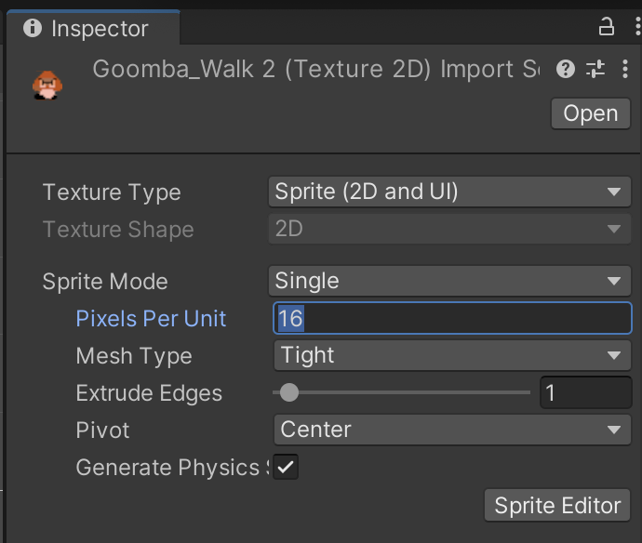
5. Goombas – set pixel per unit for asset

Slide 41
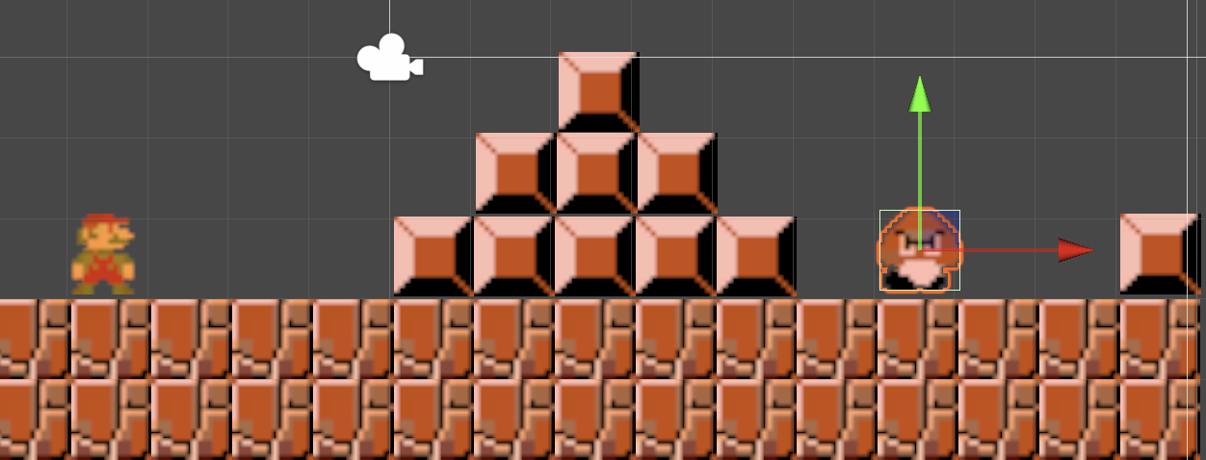
5. Goombas + Block

Slide 42


5. Goombas – add colliders

Slide 43

5. Goombas – add C# Script

Slide 44

5. Goombas – C# Code

Slide 45

5. Goombas – C# Code

Slide 46


5. Goombas – add script

Slide 47


5. Goombas – alternate direction

Slide 48
Steps / Requirements
Level Design in Unity ✅
Mario Movement (left + right) ✅
Object detection / collision ✅
Jumping over blocks / gravity ✅
Enemies (Goombas) alternate directions ✅
Jumping on Goombas – further collisions
Decoration – animation – walking
Camera to track Mario (once tile map created)

Slide 49

6. Jumping on Goombas – set tags

Slide 50

6. Jumping on Goombas – modify the collision

Slide 51

6. Goombas – C# Code

Slide 52


6. Jumping on Goombas

Slide 53
Steps / Requirements
Level Design in Unity ✅
Mario Movement (left + right) ✅
Object detection / collision ✅
Jumping over blocks / gravity ✅
Enemies (Goombas) alternate directions ✅
Jumping on Goombas – further collisions ✅
Decoration – animation – walking
Camera to track Mario (once tile map created)

Slide 54


7. Animation

Slide 55


7. Animation

Slide 56


7. Animation
Make sure you have Mario selected as you open the ‘Animation’ tab

Slide 57

7. Animation

Slide 58



7. Animation
Sprite 1
Sprite 2
Sprite 1
I found I needed a ‘copy’ of the first sprite at the end for a ‘smoother’ animation
This is so Sprite 1 and Sprite 2 had roughly the same time in the loop.

Slide 59

7. Animation
Sprite 1
Sprite 2
Sprite 1

Slide 60

7. Animation
Sprite 1
Sprite 2

Slide 61


7. Animation
Sprite 1
Sprite 2
Sprite 1

Slide 62
Steps / Requirements
Level Design in Unity ✅
Mario Movement (left + right) ✅
Object detection / collision ✅
Jumping over blocks / gravity ✅
Enemies (Goombas) alternate directions ✅
Jumping on Goombas – further collisions ✅
Decoration – animation – walking ✅
Camera to track Mario (once tile map created)

Slide 63


8. Camera – first extend the floor

Slide 64


8. Camera – update your box collider!

Slide 65

8. Camera – locate the ‘Main Camera’ object

Slide 66


8. Camera – Drag the Main Camera onto Mario
Then the camera should then move with Mario as he moves right

Slide 67
Steps / Requirements
Level Design in Unity ✅
Mario Movement (left + right) ✅
Object detection / collision ✅
Jumping over blocks / gravity ✅
Enemies (Goombas) alternate directions ✅
Jumping on Goombas – further collisions ✅
Decoration – animation – walking ✅
Camera to track Mario (once tile map created) ✅

